Slide 1

Advanced Machine Learning Techniques
Session - 5

Slide 2
Advanced MLT – Course overview
Dimensionality reduction
Principal Component Analysis
Linear Discriminant Analysis , Locally Linear Embedding
T - Distributed Stochastic Neighbour Embedding
Clustering
Hierachical Clustering
Clustering using Mixture models
Machine Learning Project Life Cycle
ML deployment, Deployment using FastAPI and cloud platforms

Slide 3
Clustering algos
Partition based (Eg: K Means)
Density based(DBSCAN)
Hierarchical(Agglomerative/divisive)
Model based (Gaussian Mixture models)

Slide 4
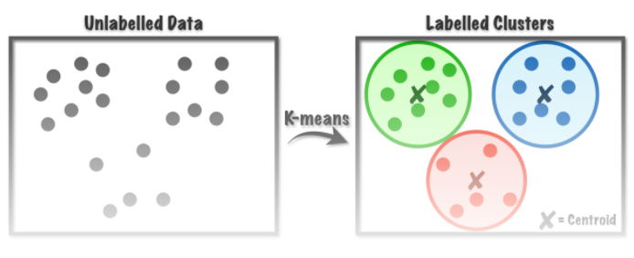
Clustering algos
Partition based (Eg: K Means)
Density based(DBSCAN)
Hierarchical(Agglomerative/divisive)
Model based (Gaussian Mixture models)

Slide 5
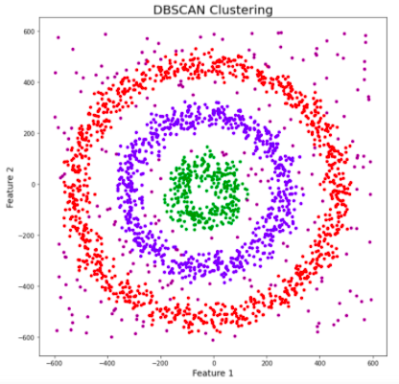
Clustering algos
Partition based (Eg: K Means)
Density based(DBSCAN)
Hierarchical(Agglomerative/divisive)
Model based (Gaussian Mixture models)

Slide 6
Model Based Clustering Gaussian Mixture Model
Probabilistic Model
Assume that Data are generated from a mixture of many Gaussian distributions.

Slide 7
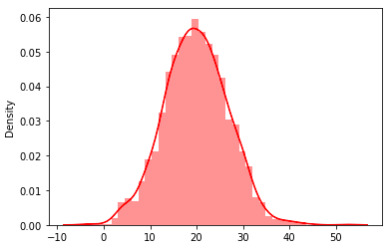

Slide 8
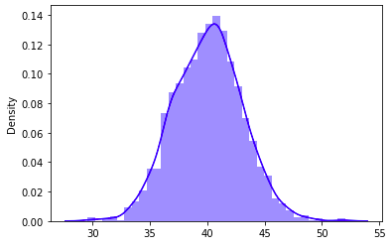

Slide 9
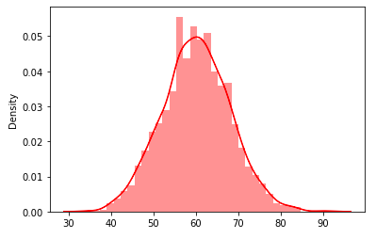

Slide 10
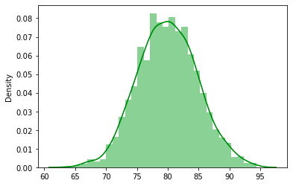
GMM

Slide 11
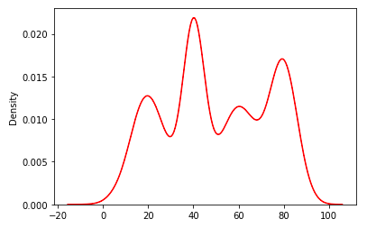
GMM

Slide 12
Clusters in GMM

Slide 13
Two-dimensional GMM

Slide 14
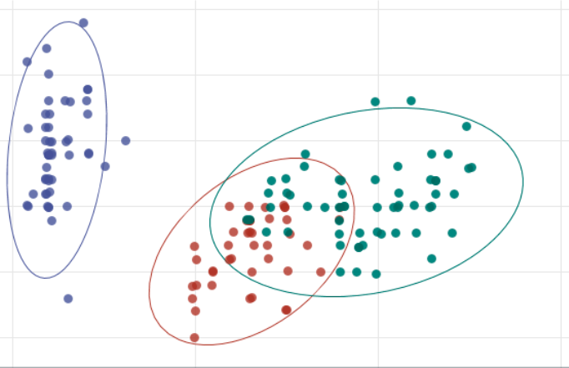
Model Based Clustering Gaussian Mixture Model
Sample from each distribution forms an ellipsoid.

Slide 15
Multi-dimensional GMM
Distribution: Unknown
Sample: Known

Slide 16
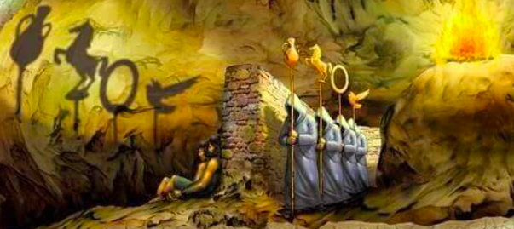

Slide 17
Observed Variable
Latent Variable.

Slide 18
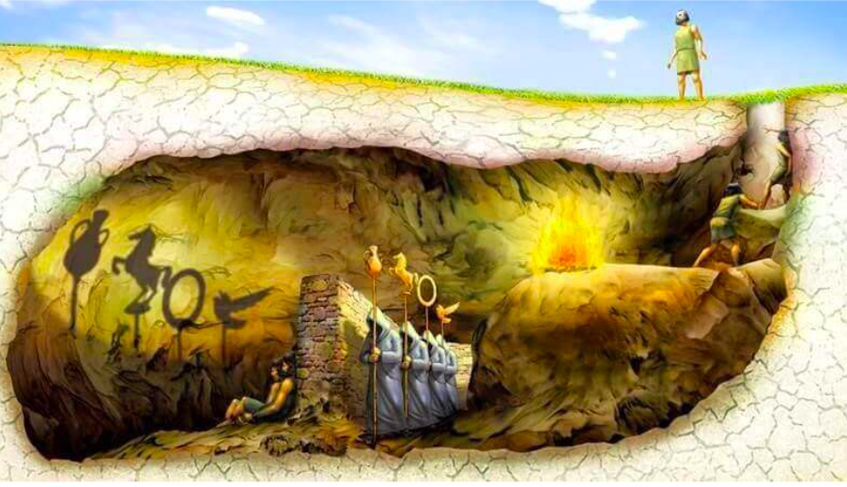

Slide 19
Finding the parameters of the Gaussian
Using Expectation-Maximization
E: Randomly allocates instances to cluster
M: Updating clusters
Similar to K – Means.
For more details:
https://www.youtube.com/watch?v=qMTuMa86NzU

Slide 20
Two important parameters:
N_clusters
N_init

Slide 21
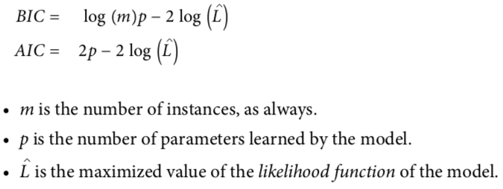
N_clusters: Using
Akaike Information Criterion(AIC)
Bayesian Information Criterion (BIC)

Slide 22
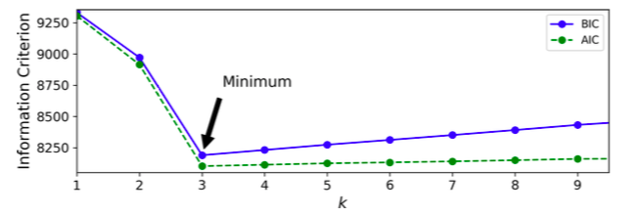
N_clusters
Focus on BIC if there is there is a difference.

Slide 23
N_init
No of times the whole process is initialised.

